Slide 1


Kingdom of Saudi Arabia Ministry of Education King Faisal University College of Computer Sciences & Information Technology
Library Management System
Course: Data Structures and Algorithms
Notes:
ID=d924773e-9a16-4d6d-9803-8cb819e99682 Recipe=text_billboard Type=TextOnly Variant=0 FamilyID=AccentBoxWalbaum_Zero

Slide 2
Group: E
Teame Members
Supervised by
Reda Alqatifi [ID]
Ali Alburahim [ID]
Mohammed Aljasem [ID]
Mahdi Alhashim [ID]
Dr. Sami Abdulsalam Alnawali
Date: December 2025

Slide 3
Project Overview
Introduction:
Key Objectives:
A console-based application developed in C++ to manage library operations efficiently.
Focuses on manipulating dynamic data using pointers rather than fixed arrays.
Implement custom Data Structures from scratch (No STL containers).
Apply efficient Sorting and Searching algorithms.
Manage Dynamic Memory Allocation to optimize performance.
Analyze Time and Space Complexity of the implemented solutions.

Slide 4
Data Structures Implemented
Doubly Linked List (For Books)
Singly Linked List (For Sections)
Structure: Each node contains Book Data + Next Pointer + Previous Pointer.
Why? Allows bidirectional traversal and efficient deletion O(1) when the node pointer is known.
Structure: Node contains Section Name + Next Pointer.
Why? Memory efficient and sufficient for linear categories display.

Slide 5
Algorithm Used: Merge Sort
The Divide and Conquer Approach: We selected Merge Sort as our primary sorting engine. Operating on the "Divide and Conquer" principle, the algorithm recursively splits the book list into smaller sub-lists until they are atomic. It then reconstructs (merges) them back together in the correct order. This recursive approach is particularly elegant and effective for Linked Lists.
Performance & Suitability: Our choice was driven by the specific nature of our data structure. Unlike Arrays, Linked Lists do not support random access, which makes algorithms like Quick Sort less efficient here. Merge Sort, however, excels with sequential access patterns. It guarantees a stable time complexity of O(N log N), making it vastly superior to basic algorithms like Bubble Sort O(N^2) for handling large datasets.

Slide 6
Algorithms: Searching
Algorithm Used: Linear Search (Smart Implementation)Method: Iterates through nodes to match user input.
Enhanced Features:
Partial Matching: Can find "Potter" using the keyword "Pot".
Case Insensitivity: Converts input and data to lowercase before comparison.
Complexity: Worst-case Time Complexity of O(N).

Slide 7
Complexity Analysis
Operation | Algorithm / Method | Time Complexity
Sorting | Marge Sort | O(N log N)
Searching | Linear Search | O(N)
Insertion | Traversal to End | O(N)
Deletion | Search & Remove | O(N)
Space | Dynamic Nodes | O(N)
Note: Space complexity is efficient as memory is allocated only when a book is added.

Slide 8
Implementation Challenges
Memory Management
One of the primary challenges in C++ is manual memory management. To prevent memory leaks, we implemented a strict garbage collection routine (clearMemoryLeak) that ensures every node is properly deleted and memory is freed when the program terminates.
Robust Input Validation
To ensure the system never crashes due to invalid user input (e.g., entering text in a price field), we built a dedicated error-handling layer. This functions as a filter, checking all inputs before processing them.

Slide 9
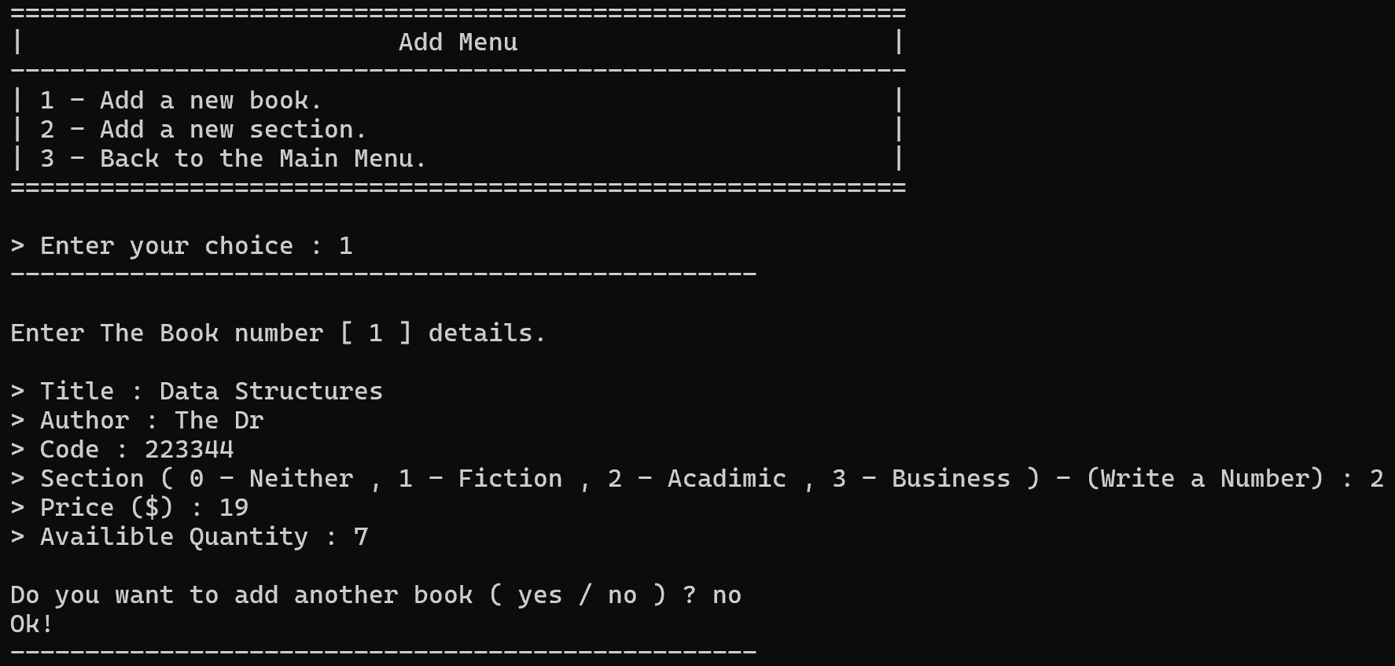
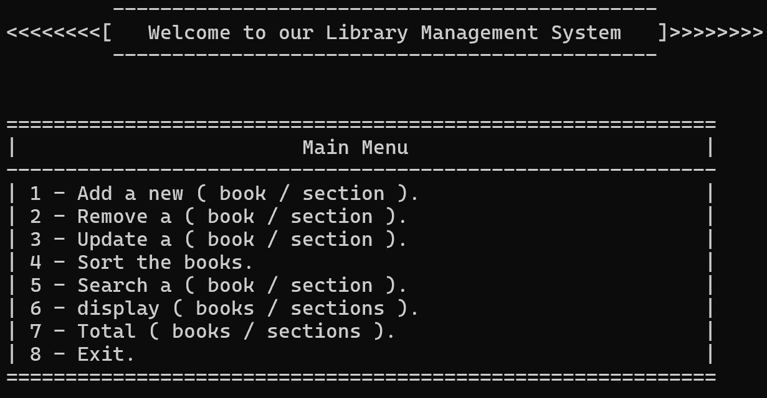
System Execution And Interface
Main Menu Interface.

Slide 10
System Execution And Interface
Adding Sections or Books:

Slide 11
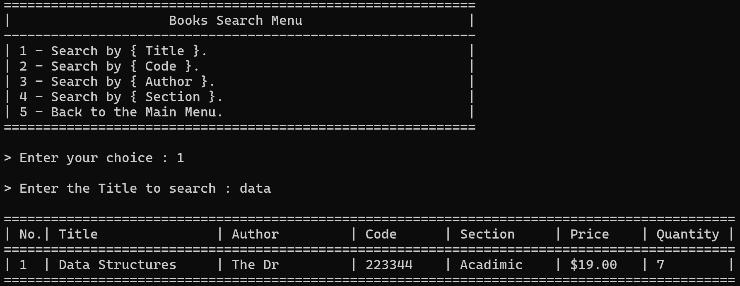
System Execution And Interface
Search Results Display:

Slide 12

Conclusion
Summary Statement: This project served as a practical application of core Data Structures. By building Linked Lists from scratch, we moved away from the limitations of fixed arrays and embraced dynamic memory allocation. The result is a modular, efficient, and stable Library Management System.

Slide 13
Thank You
Any Questions?

